Slide 1
English
Unit 1 – My World
Monday 24th August 2026
WALT: Use an increasing range of prepositions before nouns and adjectives in prepositional phrases.

Slide 2



WALT: Use an increasing range of prepositions before nouns and adjectives in prepositional phrases.
I can add the correct preposition to a sentence.
I can write my own sentences using prepositions correctly.
I can give feedback on the prepositional sentences of other students.

Slide 3
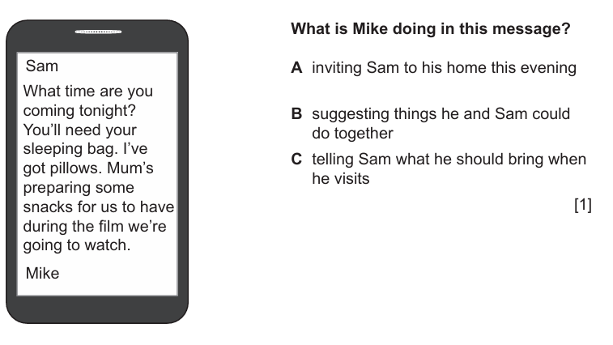
Retrieval Practice
WALT: Use an increasing range of prepositions before nouns and adjectives in prepositional phrases.

Slide 4
Retrieval Practice
WALT: Use an increasing range of prepositions before nouns and adjectives in prepositional phrases.

Slide 5
Starter– Can you spot the mistakes in these prepositional sentences?
WALT: Use an increasing range of prepositions before nouns and adjectives in prepositional phrases.
This chocolate is of Ghana.
He has the same name with me.

Slide 6
Starter– Can you spot the mistakes in these prepositional sentences?
WALT: Use an increasing range of prepositions before nouns and adjectives in prepositional phrases.
This chocolate is from Ghana.
He has the same name as me.

Slide 7
What is a preposition?
WALT: Use an increasing range of prepositions before nouns and adjectives in prepositional phrases.
A preposition is a word that shows the relationship between words.
It often tells us about:
Place: in, on, under, behind, in front of, beside, between, etc.
Time: at, on, in, before, after, during, since, until, etc.
Direction: to, from, into, out of, up, down, etc.
Manner: by, with, without, like, etc.

Slide 8
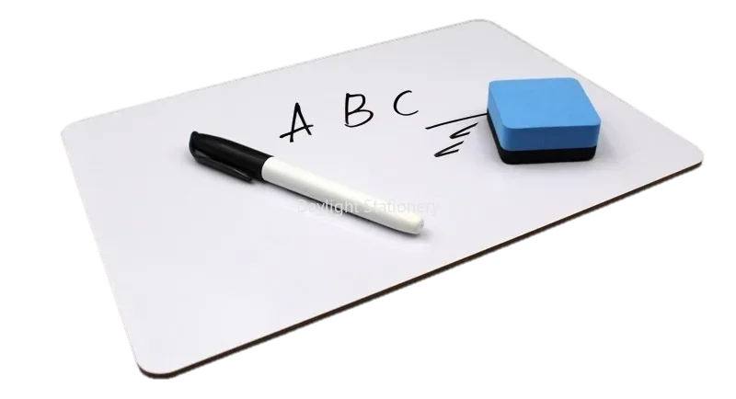
What prepositions do you know?
WALT: Use an increasing range of prepositions before nouns and adjectives in prepositional phrases.

Slide 9
WALT: Use an increasing range of prepositions preceding nouns and adjectives in prepositional phrases.
Copy these sentences into your notebook including the correct preposition:
Mongolia is ___________ China and Russia.
Lots of people travel Vietnam _______ train, travelling _________ north ________ south.
Lines of latitude are parallel ________ the equator.
The world is divided ____________ 7 continents.
Ms. Colette is _____________ the U.K.
between
by
from
to
to
into
from
Write your own sentences using as many different prepositions as you can.
Swap sentences with someone else who is finished and given them feedback.

Slide 10
WALT: Use an increasing range of prepositions preceding nouns and adjectives in prepositional phrases.
I can add the correct preposition to a sentence.
I can write my own sentences using prepositions correctly.
I can give feedback on the prepositional sentences of other students.

Slide 11
Plenary – Use the prepositions and nouns on the board to think of a sentence.
WALT: Use an increasing range of prepositions preceding nouns and adjectives in prepositional phrases.
of an orange
to the south
between the mountains
to the west
in the middle

